Slide 1

Tableau Capstone Project
E-Commerce DATASET
Submitted By
Yogesh Sadanand Hedau

Slide 2
Executive Summery
This dataset contains various details from e-commerce website.
This dataset is studied to find out the patterns in the orders get from e-commerce website.
This dataset provides details of products ordered from various states. The dataset contains 1500 Observations with 10 characteristics.
The purpose of this project is to analyze the order pattern according to product category, sub-category, quantity and profit.
DATASET SOURCE
https://www.kaggle.com/datasets
Presentation Video:
https://drive.google.com/file/d/1mqhiBz2Bnl1iB7UcrwkcAfrTcTa5ZuGv/view?usp=drivesdk

Slide 3
Problem Statements
What category of products made maximum and minimum profit ?
Top 5 products sold on website
What is the profit of the month November in year 2018 ?
What is the total profit in year 2019 ?
Which products made average profit ?
How much Clothing Products sold on website ?
Top 5 cities made highest profit
Which state made maximum profit ?

Slide 4
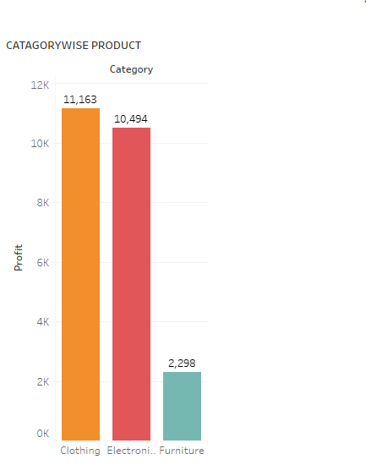
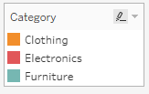
CATAGORYWISE PRODUCT
Problem Statement -1
What category of products made maximum and minimum profit ?
Answer :
Clothing products made maximum profit and Furniture products made Minimum Profit.

Slide 5
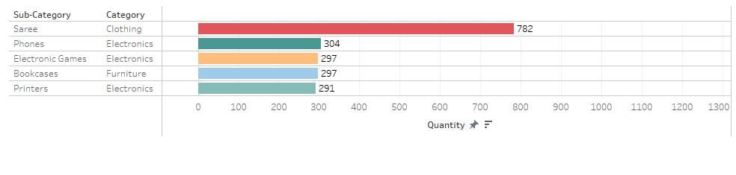
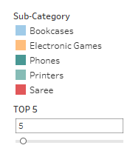
QUANTITYWISE SUB-CATAGORY OF PRODUCT
Problem Statement – 2
Top 5 products sold on website
Answer :
Saree, Phones, Electronic Games, Bookcases and Printers are the 5 products sold most on the website.

Slide 6
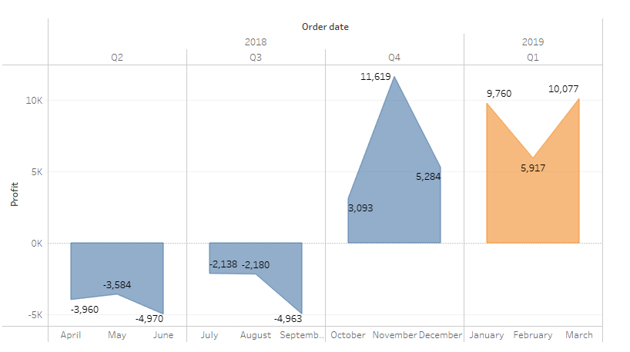
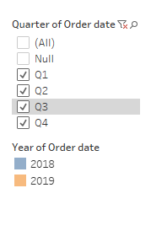
PROFIT BY YEAR

Slide 7
Problem Statement – 3
What is the profit of the month November in year 2018 ?
Answer :
In November 2018 profit is 11619.
Problem Statement – 4
What is the total profit in year 2019 ?
Answer :
In 2019 total profit is 25754.

Slide 8
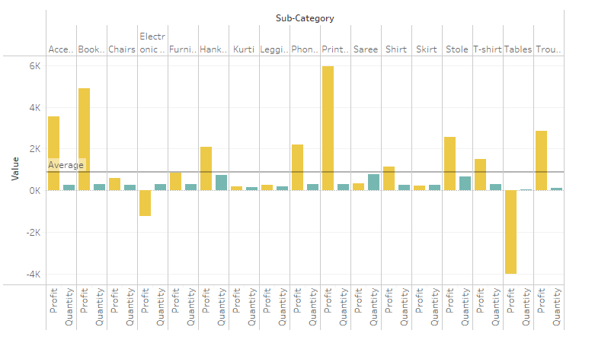
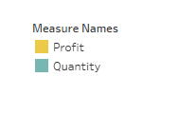
QUANTITY AND PROFIT OF PRODUCTS
Problem Statement – 5
Which products made average profit ?
Answer :
Acessories, Bookcases, Hankerchiefs, Phones, Printers, shirts, stole, T-shirts and trousers are the products made average profit.

Slide 9
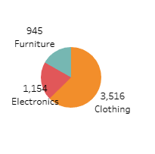
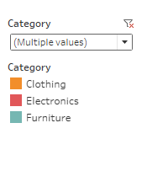
CATAGORYWISE QUANTITY OF PRODUCTS
Problem Statement – 6
How much Clothing Products sold on website ?
Answer :
3516 Clothing products sold on website.

Slide 10
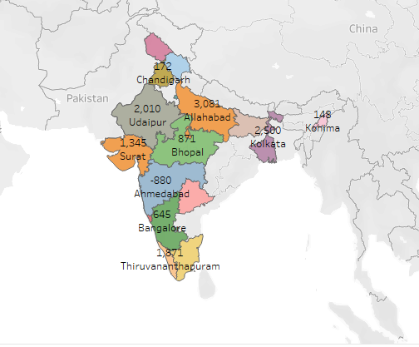
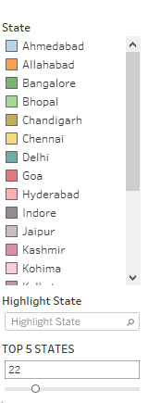
STATEWISE PROFIT OF PRODUCTS

Slide 11
Problem Statement – 7
Top 5 cities made highest profit
Answer :
Delhi, Indore, Pune, Mumbai and Bhopal are cities made highest profit.
Problem Statement – 8
Which state made maximum profit ?
Answer :
Delhi made maximum profit of 3508.

Slide 12
Conclusion
In this E-Commerse dataset we analyse the various details of e-commerse website.
Clothing products made maximum profit and Furniture products made Minimum Profit.
Delhi made maximum profit of 3508.
Printers and bookcases are the products made highest profit among all products.
In 2019 website makes more profit than 2018.

Slide 13
THANK YOU !!!

